Slide 1
A New Strategy for Coarse-Grained Protein Simulations: Smoothed Energy Tables
Justin Spiriti
Zuckerman Lab
MMBioS meeting
5/22/2014

Slide 2
Why novel coarse-grained methods?
Coarse grained force fields
  Represent multiple atoms by a single particle
  Computational speedup from reduced number of particles
  Improved sampling from a smoother free energy surface
Significant limitations
  Bias toward native structures/structures in the PDB
  Difficulties modeling secondary structures/charge distributions
  Lack of transferability
Hard to adjust amount of coarse graining
Previous work – Lettieri and Zuckerman, JCC 2012, 33, 268
  Used smoothed energy tables to model benzene
  Achieved overall 114-fold speedup

Slide 3
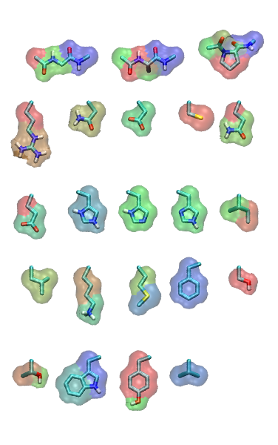
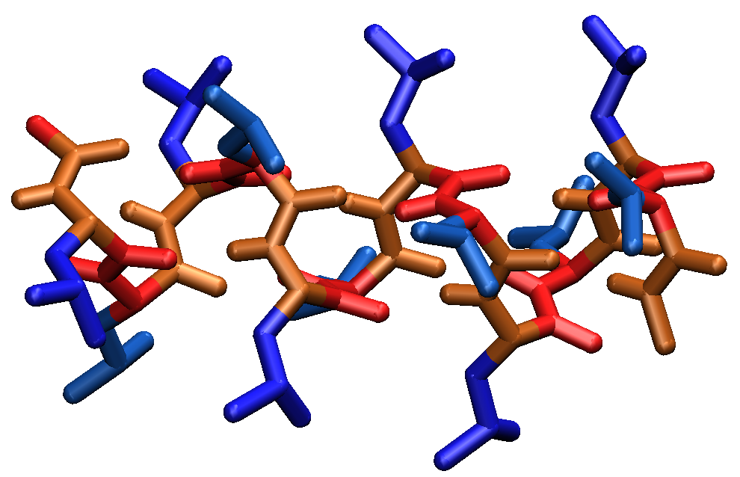
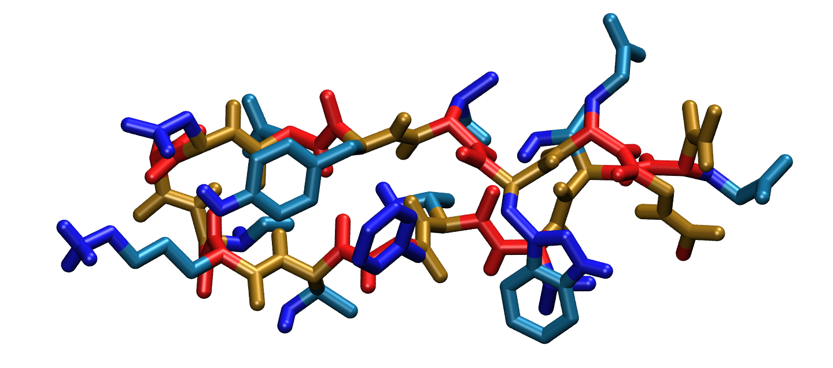
Dividing amino acids into fragments
Gly
Ala
Pro
Ace-Leu₁₂-Nme (Leu12)
Arg
Asn
Asp
Cys
Gln
Glu
His⁺
His^{δ}
His^{ε}
Ile
GB1 hairpin
Leu
Lys
Met
Phe
Ser
Thr
Trp
Tyr
Val

Slide 4
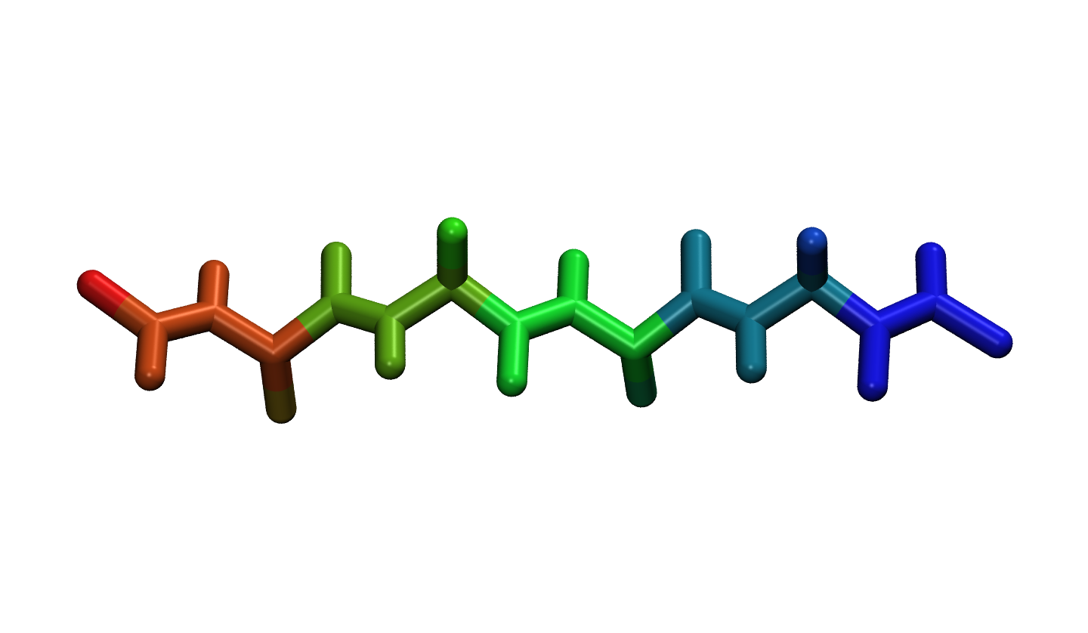
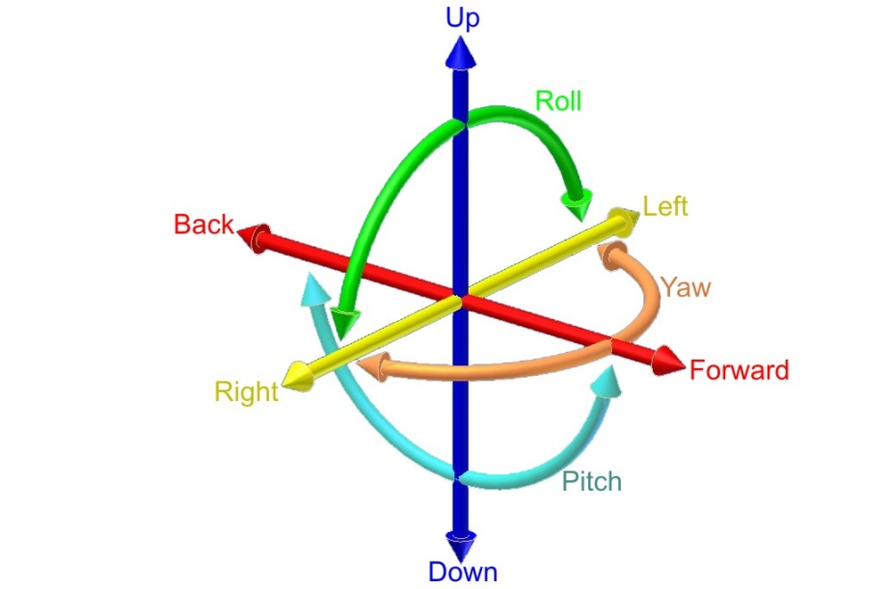
Interaction energy tables
6D interaction energy table for each pair of fragment types (sub-Å resolution)
Use to compute energy in Monte Carlo simulations
(r,θ,ϕ,ϕ’,θ’,ψ’)
(r,θ,ϕ)
(ϕ’,θ’,ψ’)
2nd fragment
r
θ
ϕ
Reference fragment configuration

Slide 5
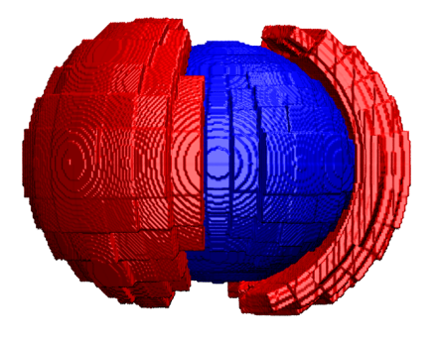
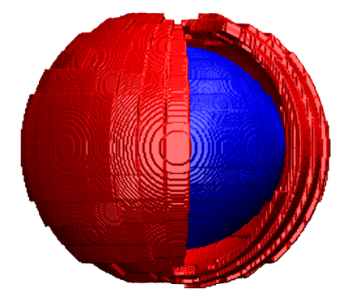
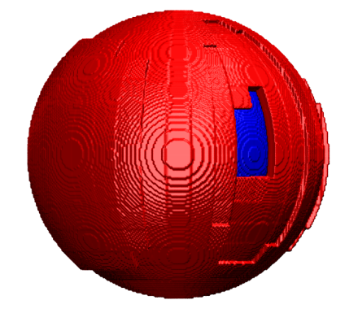
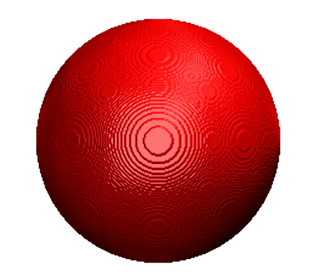
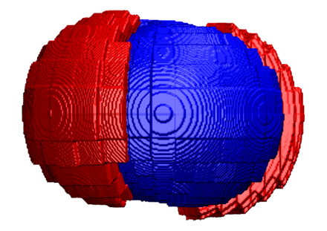
Smoothing energy tables
Convolve the Boltzmann factor e^{-βU} with a Gaussian kernel function over the spherical angles (θ,ϕ) and the Euler angles (ϕ’,θ’,ψ’)
Angular scale of Gaussian can be used to control degree of smoothing
Association free energy of two fragments (related to second virial coefficient) unchanged by smoothing
none
20°
40°
60°
infinite
Increasing smoothing

Slide 6
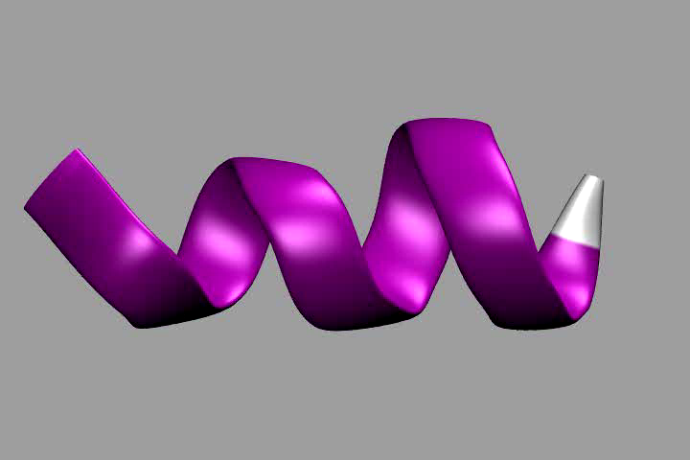
Leu12 with 60° smoothing

Slide 7
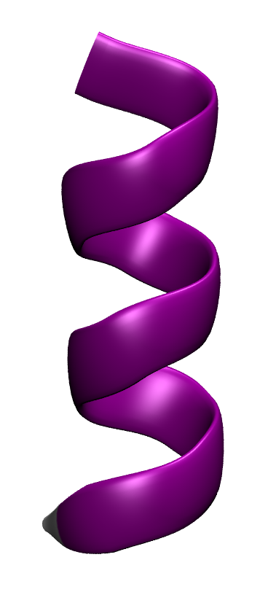
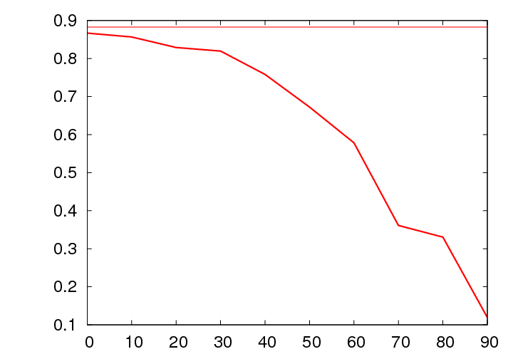
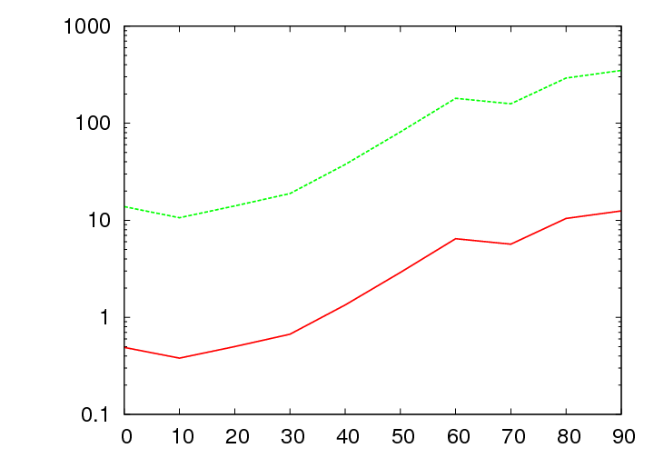
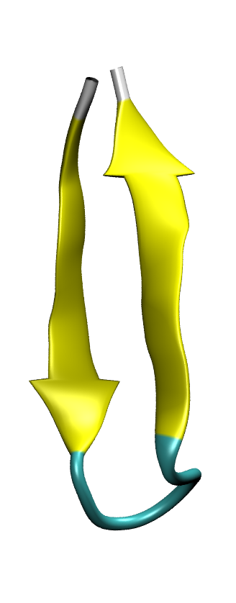
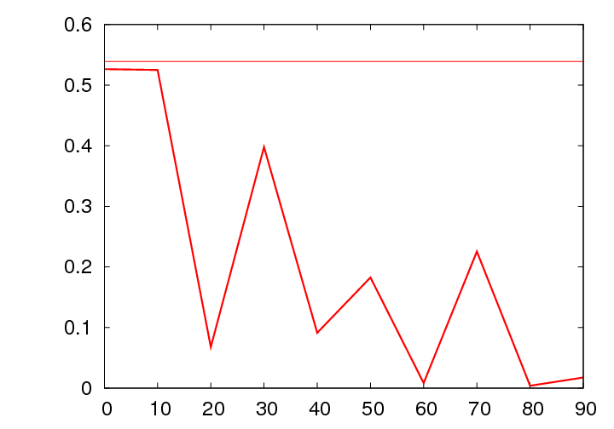
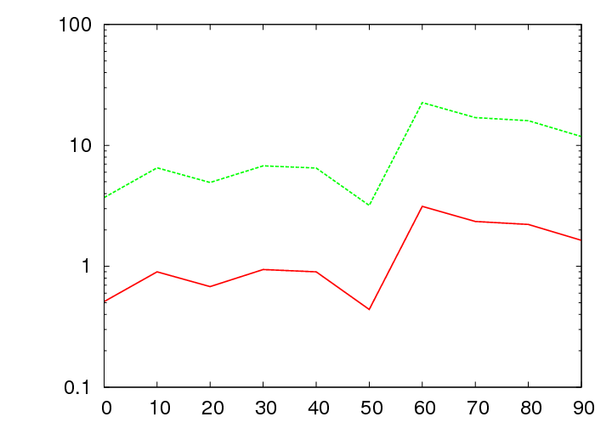
Preliminary results
Leu12
no tables
vs. all-atom MD
Fraction α-helix
speedup factor
vs. MC w/o tables
GB1 hairpin
vs. all-atom MD
no tables
Fraction β-sheet
speedup factor
vs. MC w/o tables
smoothing (°)
smoothing (°)
Speedup factor based on computational savings and improved sampling (as measured by increase in Ramachandran angle transition rates)

Slide 8
Future Directions
Proteins as rigid fragments
  Use energy table for protein/protein interactions
  Preliminary work by Aaron van Dyne on barnase/barstar (TECBio 2013)
  Viral capsid assembly
  Incorporate into MCell to allow for electrostatics/protein shape/orientation dependent kinetics
Continued work on molecular scale
  Improved smoothing/fragment shape preservation
  Better solvation methods
  Possible mixed resolution applications

Slide 9
Technical details of simulations
CHARMM 19 united atom force field with ε=2r
5 billion trial moves (backbone/sidechain dihedral rotations, “backrub” rotations between C^{ɑ} atoms_
Radial resolution of table proportional to distance between fragments
 | Polar fragments | Nonpolar fragments
r | 0.1-0.6 Å | 0.2-1.2 Å
θ,ϕ | 10° | 20°
ϕ’,θ’,ψ’ | 30° | 30°
System | Total size (GB)
Leu12 | 1.36
GB1 hairpin | 2.79
Complete set (all 20 amino acids) | 15.04

Slide 10
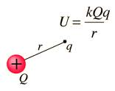
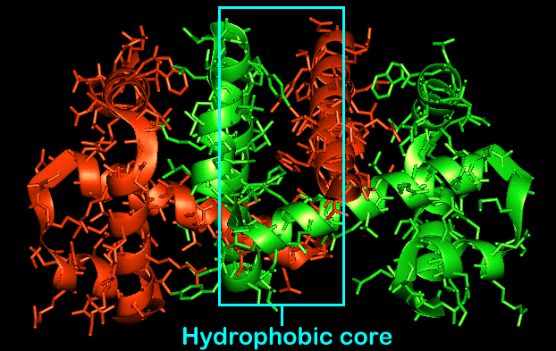
Interaction energy tables for whole proteins
Clash table Electrostatics table Water interactions
(Hydrophobic
contact table)

Slide 11
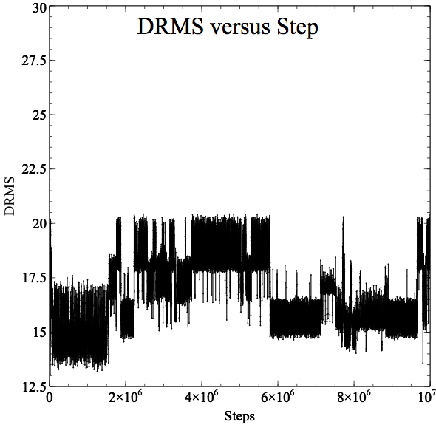
Barnase/barstar DRMS
A measure of how close the structure is to the crystal structure.
Closer to 0 means a closer match.

Slide 12
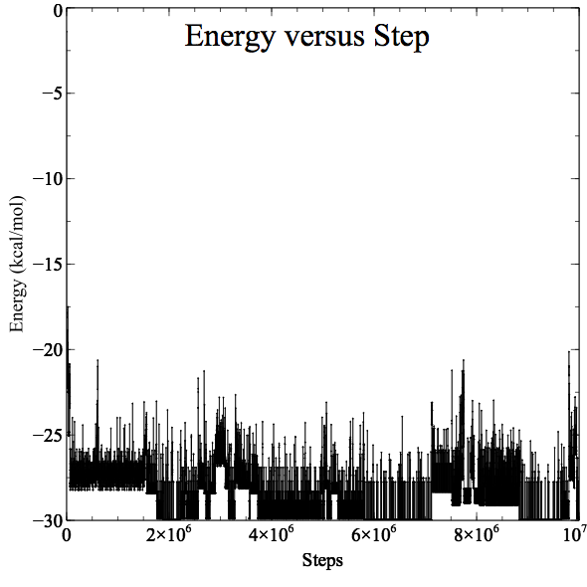
Energy
Changes in energy represent transitions in configuration
Lower energy configurations are more stable

Slide 13
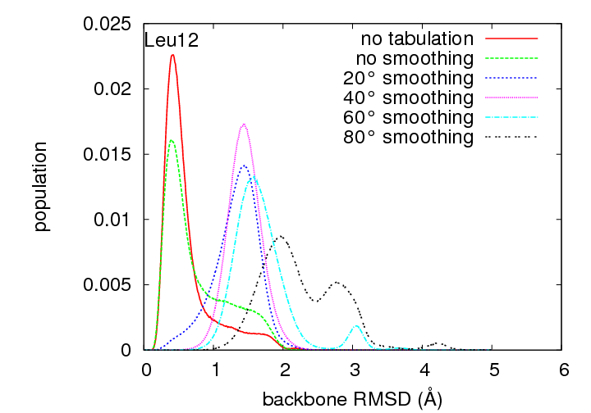
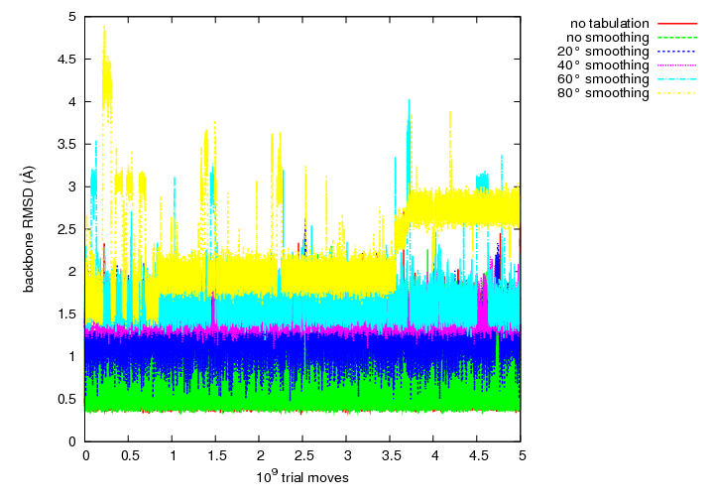
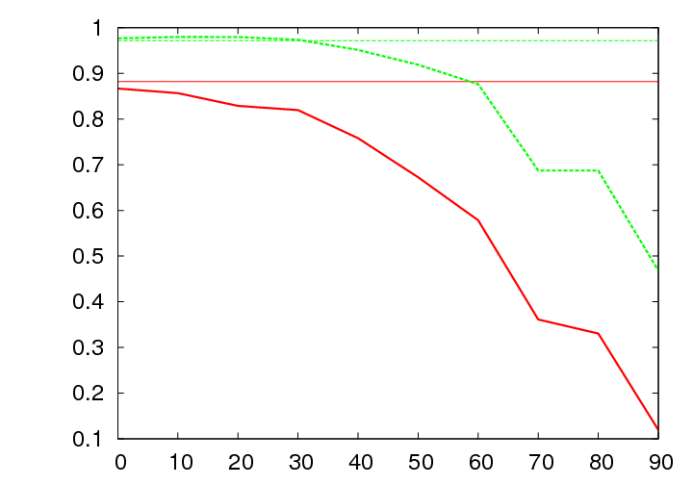
Extend tabulated MC simulations of Leu12
Fraction α-helix
smoothing (°)

Slide 14
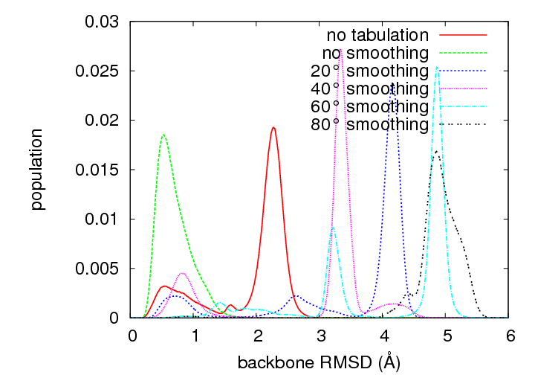
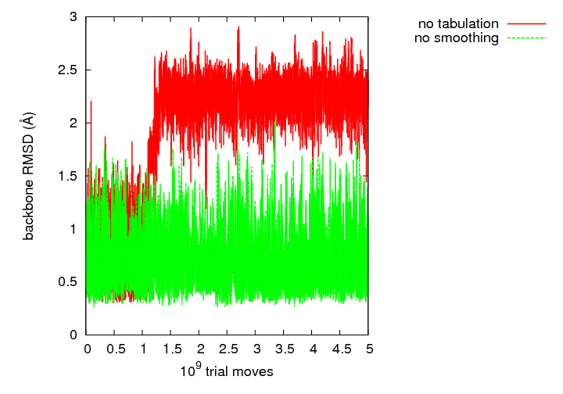
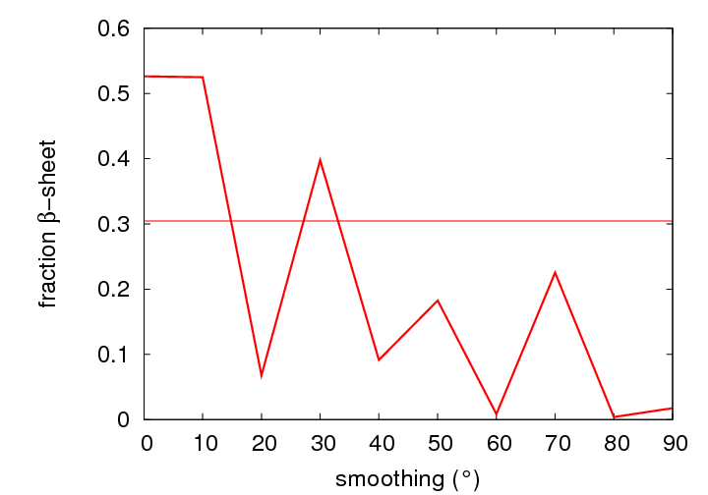
…and the GB1 hairpin

Slide 15
Overview of solvation possibilities
Explicit Water | Add a water fragment along with corresponding smoothed tables and use periodic boundary conditions.
Tabulated Generalized Born | Approximate the Still formula so that it can be tabulated and redesign the tables as needed.
Generalized Kirkwood | For the purposes of solvation, treat each fragment as a spherical particle with charge and dipole, and use a generalized Kirkwood cross-term (similar to Still formula).
Solvent-Accessible Surface Area | Add a surface area based solvation term of the form Σσ_{i}A_{i}. Compute surface areas with or without tables.

Slide 16
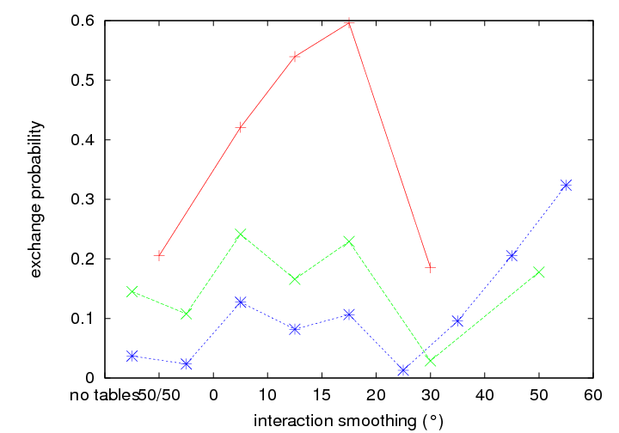
Hamiltonian “resolution” exchange
Leu12
GB1 hairpin
60°
Met-enkephalin
50°
40°
30°
GB1 hairpin
Leu12
20°
15°
10°
0°
50/50*
no tables

Slide 17
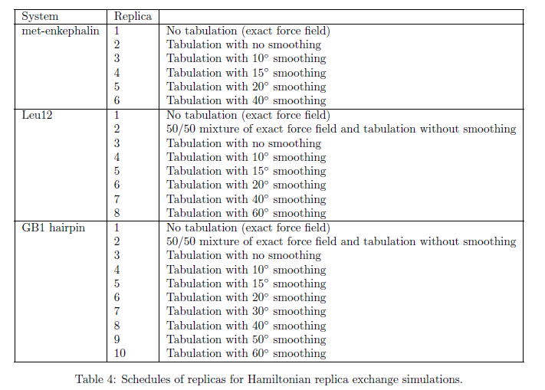
Replica exchange levels

